Slide 1
Chapter 2 Logic Simulation
電機系
電路邏輯模擬

Slide 2
Logic Simulation
Purposes
  Verification
  Debugging
  Studying design alternative (cost/speed)
  Computing expected behavior for tests
Simulation-based design verification
  To check correct operations:
    e.g. delays of critical paths
    free of critical races & oscillation
  Problem is that tests are hand crafted; Very hard to prove that a test is complete.
  Formal and assertion-based verification required

Slide 3
Modeling for Circuit Simulation
Circuit models
  Modeling levels
    Behavioral, logic, switch, timing, circuit
  Modeling description (languages)
Signal models
  Logic value models
  Timing value models
Choices of models determine the complexity and accuracy of simulation

Slide 4
Level of Circuit Modeling (1/2)
Electronic system level
  Software+hardware
  Transaction/cycle-accurate functions
  C/C++, SystemC, SystemVerilog, etc.
Register-Transfer-Level (RTL)
  Define bit and timing (almost) accurate architecture for sign-off
  VHDL and Verilog
Logic/cell/gate level
  Interconnected Boolean gates
    AND, OR, NOR, NAND, NOT, XOR, Flip-flops, Transmission gates, buses, etc.
  Suitable for logic design, verification and test
Notes:
1.Function/Boolean level modeling:
architecture level
modules are expressed in programming language construct
Register-transfer level (RTL)
testbench: the part of HDL code added for stimulus generation
Logic level:
interconnect of Boolean gates including
simple gates: or, nor, not, and, nand
complex gates: xor
transmission gates, bus
Switch level:
interconnect of MOS transistor (treated as an ideal switch) plus transistor size and node capacitance
determination of logic states is complex
can simulate logic ckts w/o exact logic structure -> good for high-performance ASIC
fault propagation is complicated
Circuit level:
interconnect of transistors, R, L, C
time-consuming
for digital ckts, only used in critical timing analysis

Slide 5
Level of Circuit Modeling (2/2)
Switch level
  Interconnects of ideal transistor switch
  Need transistor size, node R and C to determine logic value
    Zero delay in timing
  Suitable for full-custom high-performance ASIC
Timing level
  Use transistors with detailed device models
  Calculate charge/discharge current with transistor’s voltage-current model and obtain node voltage as a function of time
  Mainly for post-PR timing verification, e.g., Timemill™
Circuit level
  Lowest level, ultimate in simulation accuracy
  Obtain timing by solving the equations relating branch/loop current and node voltage
  Critical timing analysis for digital circuits
  Mixed-signal circuit simulation
Notes:
1.Function/Boolean level modeling:
architecture level
modules are expressed in programming language construct
Register-transfer level (RTL)
testbench: the part of HDL code added for stimulus generation
Logic level:
interconnect of Boolean gates including
simple gates: or, nor, not, and, nand
complex gates: xor
transmission gates, bus
Switch level:
interconnect of MOS transistor (treated as an ideal switch) plus transistor size and node capacitance
determination of logic states is complex
can simulate logic ckts w/o exact logic structure -> good for high-performance ASIC
fault propagation is complicated
Circuit level:
interconnect of transistors, R, L, C
time-consuming
for digital ckts, only used in critical timing analysis

Slide 6
Logic States for Simulation
Two states (0, 1) for combinational and sequential circuits with known initial states.
Three states (0, 1, X) for sequential circuits with unknown initial states
  X (unknown state) for cases when the logic value cannot be determined
  X can be either 0 or 1.
  Sources: uninitialized FF, bus, memory, multi-cycle paths, etc.

Slide 7
Logic Operations with X
AND | 0 | 1 | x
0 | 0 | 0 | 0
1 | 0 | 1 | x
x | 0 | x | x
OR | 0 | 1 | x
0 | 0 | 1 | x
1 | 1 | 1 | 1
x | x | 1 | x

Slide 8
Problems with the 3-Valued Logic
May cause information loss
  Fail determining the logic value even though that value can be easily determined
  Example:
  The output is evaluated as x even though it should be 1 regardless of the actual value of x
1
x
x
x
x
x
1

Slide 9
Symbolic Simulation of “x”
Treat “x” as a signal
  NOT x = x’
  x + x’ = 1
Problem
  There can be multiple sources of X, e.g., Flip-flops
  One “x” for each unknown value (x1, x2, …)
  Impractical for large circuits, e.g., x1 + x2 = ?
1
x
x
1
x’
x’
1

Slide 10
High-Impedence State Z
Floating state: a node w/o conducting path to either Vdd or Gnd
Logic state of Z is interpreted dynamically
  Single floating node
    Same as its driven value before becoming floating
  A set of floating nodes get connected
    Depends on charge sharing, may become uncertain
  A floating node connected to Vdd/Gnd becomes 1/0
  When multiple source drive a floating node, the value depends on the strength of the driving logics.
Most MOS circuits containing dynamic logic require four states (0,1, x, z) for simulation

Slide 11
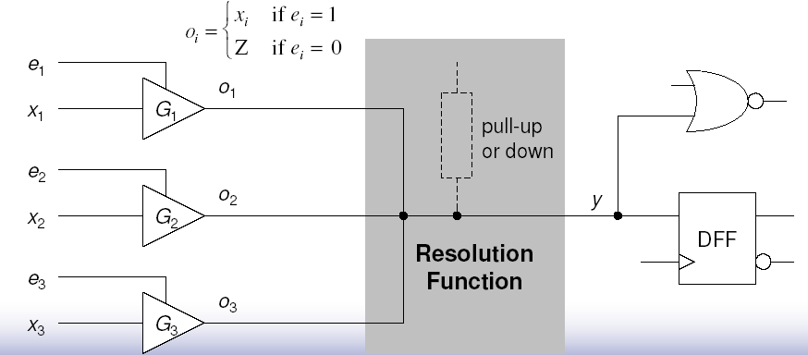
An Example of High-Z Bus

Slide 12

Delay (Timing) Models
Delay of a logic element
  Time between an input change (cause) and the output change (effect), e.g. C->E or D->E
  Called gate delay, pin-pin delay, or switching delay
Interconnect delay
  Time between the generation of a signal transition at a gate output and its arrival at the input of a fanout gate, e.g. A->C, or B-> D
  Or called switching delay
  Consider R, C (L) effects
A
C
E
A
C
D
B

Slide 13
Terms for Cell Delay Models
Zero and unit delay
Rise (fall) delay
  Gate delays of different final output states
Inertia delay
  Minimum pulse width to cause a transition
  Used for filtering input/output pulse
  Input inertia delay: minimum pulse width for input
  Output inertia delay: minimum pulse width for output
Min/Max Delay
  The minimum or maximum bound of a gate delay
Transition time
  Time for a signal to transit from 0 to 1 or 1 to 0.

Slide 14
Delay Models Examples
A
3
transport delay = 2
(transition-independent)
C
2
3
1
3
rise delay = 1
fall delay = 3
C
1
1
min-max delay
(transition independent)
1 ≤ d ≤ 3
C
3
3
input inertia delay = 4
C
input inertia delay = 2
& transport delay = 2
2
C
3

Slide 15
Common Cell Delay Models
Table-based
  A pin-pin min/max rise/fall delay of a cell = f(CL, Tr)
  CL=output load
  Tr=input transition time
Current-source based
  A voltage-controlled current source I(Vi, Vo)
  I: Vdd to Gnd current
  Vi: input voltage
  Vo: output voltage
  More accurate in terms of noise, but more CPU intensive
Interconnect delays
  Elmore delay

Slide 16
Modeling Levels and Signals
level | Circuit Description | Signal | Timing Resolution | Application
ESL | SystemC | 0,1 | transaction | system
Behavior | HDL | 0,1 | cycle | architecture
Logic | gate-level HDL | 0, 1, X, Z (with signal strength) | zero, unit, multiple cell delays | logic design and test
Switch | transistor, RC interconnects | 0, 1, X (with signal strength) | zero, possible gross-grain timing | full-custom logic verification
Timing | same as above (SPICE) | Analog | fine-grain time | timing verification
Circuit | same as above (SPICE) | Analog | continuous time | timing/analog verification

Slide 17
Types of Logic Simulators
Compiled-driven simulators
  The compiled code is generated from an RTL or gate-level description of the circuit
  Simulation is simply execution of the compiled code
Event-driven Simulators
  Simulate only those signals with value changes
  Only propagate necessary events (value changes)

Slide 18
Compiled Simulation
A circuit is simulated by executing a compiled code of the circuit.
Levelization
  to ensure that a signal is evaluated after all its sources are evaluated
a
e
Levelization
Assign all PI’s level 0
The level of gate G is
Lg = 1 + max(L1,L2,…)
where Li’s are G’s input
gates
b
g
f
c
h
d
level 0: a, b, c, d
level 1: e, f
level 2: g, h

Slide 19
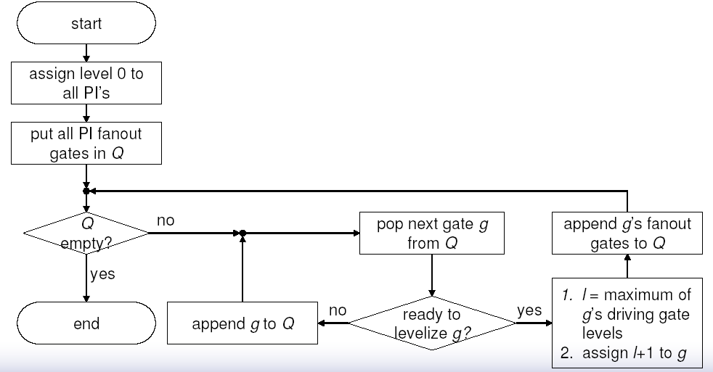
Flow of Levelization

Slide 20
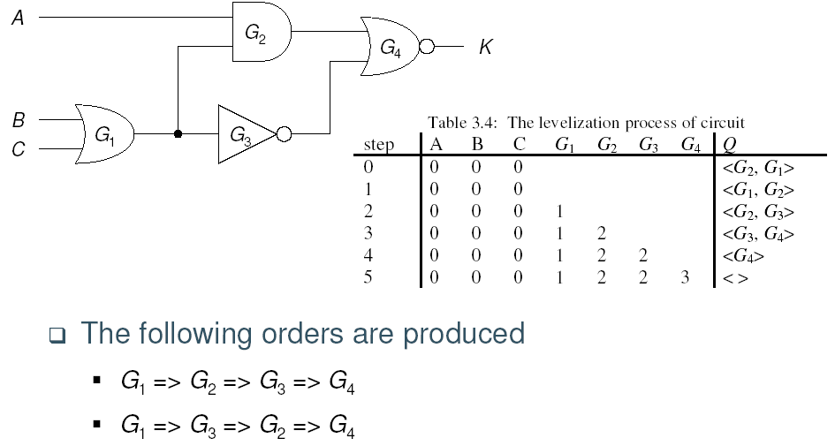
Example of Levelization

Slide 21
Compiled Simulation – cont’d
Code generation & execution
Very effective for 2-state (0,1) simulation
  Can be compiled directly into machine codes
Mainly for functional verification, where timing is irrelevant
while (1) {
read_in(a,b,c,d);
e = AND(a,b);
f = NOR(b,c);
g = OR(e,f);
h = NAND(d,f);
print_out(g,h);
}
a
e
b
g
f
c
h
d

Slide 22
Compiled Simulation – Example in C
Code generation in C
#include <stdlib.h>
int main(){
unsigned int a=0xF; //1111
unsigned int b=0xA; //1010
unsigned int c=0x8; //1000
unsigned int d=0x7; //0111
unsigned int e, f, g, h;
e = a&b;
f = ~(b|c);
g = e|f;
h = ~(d&f);
printf("g,h=%X,%X", g, h);
}
a
e
b
g
f
c
h
d

Slide 23
Problems with Compiled Simulation
Zero-delay model
  Timing problems, e.g., glitches and races, cannot be modeled
Simulation time could be long
  Proportional to Ω(input vectors×number of gates)
  Entire circuit is evaluated even though typically only 1-10% of signals change at any time
  Note RTL compiled simulation is different and fast, since branching can be used.

Slide 24
Event-Driven Simulation
An event is a change in value of a signal line
An event-driven simulator evaluates a gate (element) only if one or more events occur at its inputs
  Only does the necessary amount of work
  Follows the path of signal flow
0
1
1
0
0
1
0
0 => 0
1 => 1
0 => 1

Slide 25
Zero-Delay Event-Driven Simulation
Read in initial state
information
More input
vector?
No
Stop
Yes
Yes
Read in new i/p vector,
and put the fanout gates
of the PIs with events in
event queue Q.
Is Q empty?
No
Evaluate next g in Q.
If g changes state,
put its fanout gates
in event queue Q.

Slide 26
Gate Evaluation – Table Lookup
The most straightforward and easy way to implement
  For binary logic, 2^{n} entries for n-input logic element
  May use the input value as table index
  Table size increases exponentially with the number of inputs
Could be inefficient for multi-valued logic
  A k-symbol logic system requires a table of 2^{mn} entries for an n-input logic element
  m = log₂k
  Table indexed by mn-bit words

Slide 27
Gate Evaluation – Input Scanning
Assume that only dealing w/ AND, OR, NAND, and NOR primitive gates
These gates can be characterized by controlling value c and inversion i
  The value of an input is said to be controlling if it determines the gate output value regardless of the values of other inputs
 | c | i
AND | 0 | 0
OR | 1 | 0
NAND | 0 | 1
NOR | 1 | 1

Slide 28
Input Scanning – cont’d
I/P of a 3-input primitive gate |  |  | O/P
c | x | x | c⊕i
x | c | x | c⊕i
x | x | c | c⊕i
c’ | c’ | c’ | c’⊕i
Evaluate(G,c,i){
u_values = false;
for every input value v of G{
if (v == c) return c⊕i;
if (v == x) u_values = true;
}
if (u_values) return x;
return c’⊕i;
}

Slide 29
Gate Evaluation – Input Counting
To evaluate the output, it’s sufficient to know
  Whether any input equals c
  If not, whether any input equals x
Simply maintain c_count & x_count
  Example: AND gate
    0 => 1 at one input: c_count--
    0 => x at one input: c_count--, x_count++
Evaluate(G,c,i){
if (c_count > 0) return c⊕i;
if (x_count > 0) return x;
return c’⊕i;
}

Slide 30
Event-Driven Simulation with Delays
While ( event list is not empty ){ t = next time in list; process entries for time t;
}
The key is to construct a queue entry for every time point

Slide 31
Time wheel
Event Lists
t=max
t=0
Current time ptr
t=1
t=2
t=3
t=4
t=5
Max units is the largest delay experienced by any event
  All gates + interconnects
  A total of max+1 slots

Slide 32
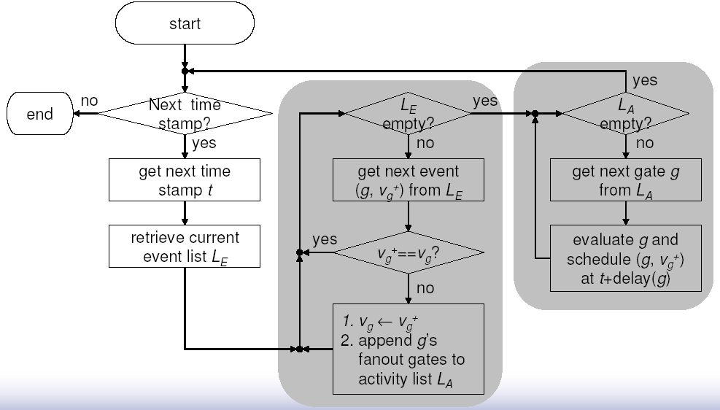
Flow of Simulation with Delays
Algorithm 1 (two-pass)
evaluates the activated gates and schedules their computed values.
Pass 1
retrieves the entries from event list & determine the activated gates.
Pass 2

Slide 33
Simulation with Delays
Algorithm 1
Activated = φ
For every event (g, v_{g}⁺) at list of time t { //from L_{E}
if (v_{g}⁺ ≠ v_{g} ) // v_{g} is the original value at signal g {
v_{g} = v_{g}⁺;
for every j on fanout list of g {
update input value of j;
add j to L_{A} if j is not a member of L_{A}; } /* for */
} /* if */
} /* for */
For every g ∈ L_{A}{
  v_{g}⁺ = evaluate (g);
  schedule (g, v_{g} ⁺ ) for time t+delay(g);
}

Slide 34
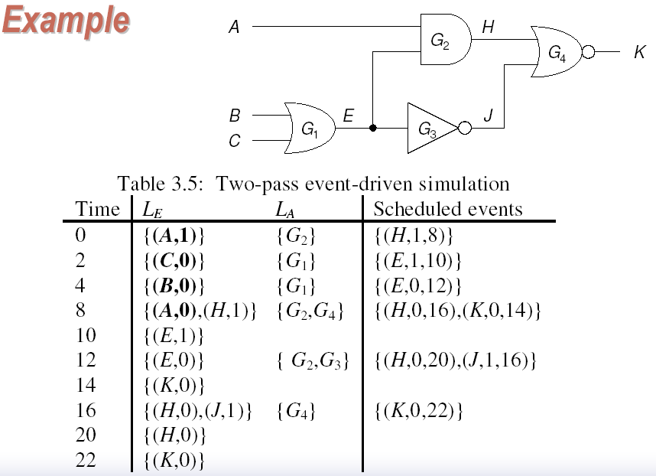
Two-Pass Algorithm
0
0
1
1
1
0
1
Gate delay
G1: 8ns
G2: 8ns
G3: 4ns
G4: 6ns

Slide 35
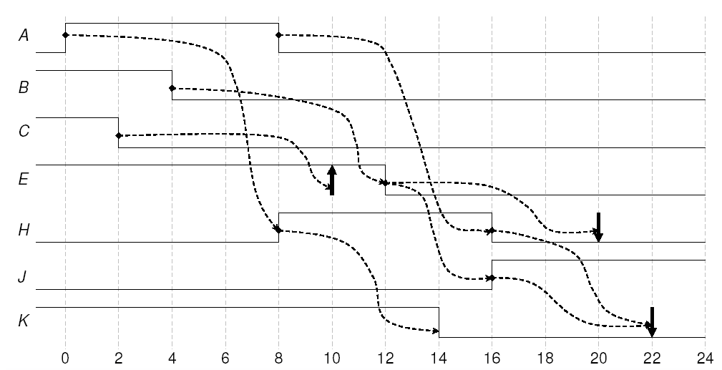
Example (Cont.)

Slide 36
Example of Algorithm 1 to schedule a Null Event
a
8
z
b
a
0
4
b
2
z
Time 0 : event (a, 1) evaluate z=1 ⇒ (z,1) scheduled for time 8
Time 2 : event (b, 0) evaluate z=0 ⇒ (z, 0) scheduled for time 10
Time 4 : event (a, 0) evaluate z=0 ⇒ (z, 0) scheduled for time 12 The last scheduled event (at t=12) is not a real event!!
8
10

Slide 37
An Improved Algorithm
Change Pass 2 to:
For every j ∈ Activated {
v_{j}′ = evaluate (j); if (v_{j}′ ≠ lsv(j)) (lsv: last saved value)
{ schedule (j, v_{j}′) for time t+d(j); lsv(j) = v_{j}′;
}
}

Slide 38
Two Pass V.S. One Pass Algorithm
Two-pass strategy performs the evaluations only after all the concurrent events have been retrieved
  to avoid repeated evaluations of gates having multiple input changes.
Experience shows, however, that most gates are evaluated as a result of only one input change.
One-pass strategy:
  Evaluates a gate as soon as it is activated
  Avoids the overhead of building the Activated set

Slide 39
One Pass Algorithm
For every event (g, v_{g}⁺) pending at current time t {
v_{g} = v_{g}⁺ ;
for every j on the fanout list of g {
    update input values of j;
    v_{j}⁺ = evaluate (j);
if (v_{j}⁺ ≠ v_{j}) {
schedule (j, v_{j}⁺) for time t+d(j); v_{j} = v_{j}⁺; }
}
}

Slide 40
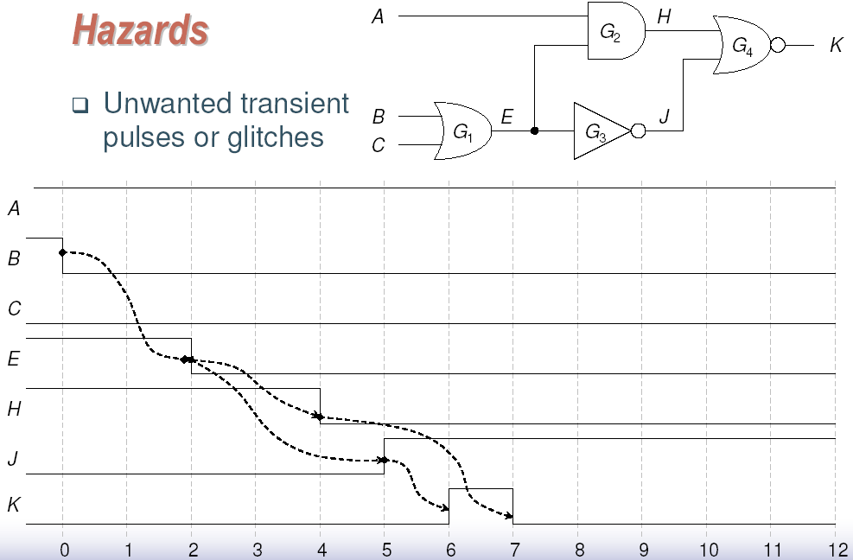
An Example of Hazards

Slide 41
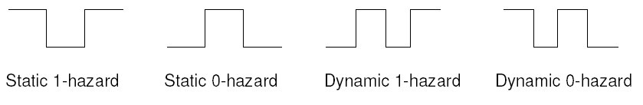
Type of Hazards
Static or dynamic
  A static hazard refers to the transient pulse on a signal line whose static value does not change
  A dynamic hazard refers to the transient pulse during a 0-to-1 or 1-to-0 transition
1 or 0

Slide 42
Static Hazard Detection
Extra encoding can be used to detect hazards during logic simulation.
  Note that hazards only occur during signal transition
  Two consecutive vectors are considered simultaneously
The following is the 6-valued encoding for a pair of vectors.
  For example, 0->1 transition (R) is encoded as 0X1.
Value | Sequence(s) | Meaning
0 | 000 | Static 0
1 | 111 | Static 1
0/1, R | {001,011} = 0x1 | Rise (0 to 1) transition
1/0, F | {110,100} = 1x0 | Fall (1 to 0) transition
0* | {000,010} = 0x0 | Static 0-hazard
1* | {111,101} = 1x1 | Static 1-hazard

Slide 43
6-Valued Logic for Static Hazard Analysis
AND | 0 | 1 | R | F | 0* | 1*
0 | 0 | 0 | 0 | 0 | 0 | 0
1 | 0 | 1 | R | F | 0* | 1*
R | 0 | R | R | 0* | 0* | R
F | 0 | F | 0* | F | 0* | F
0* | 0 | 0* | 0* | 0* | 0* | 0*
1* | 0 | 1* | R | F | 0* | 1*

Slide 44
Oscillation
Oscillating circuits will result in repeated scheduling & processing of the same sequence of events
Oscillation control takes appropriate action upon detection of oscillation
S = 1=>0=>1
3
S
4
y
3
3
y
3
y’
3
R = 1
y’
3

Slide 45
Local Oscillation Control
identify conditions that causes oscillations in specific sub-circuits, e.g., latches, flip-flops
  For an oscillating latch, the appropriate corrective action is to set y = y’ = x (unknown)
Oscillation control via modeling
  Example: when y=y’=0 (oscillation condition, also implying S=R=1), G = x causes y = y’ = x and stops oscillation
S
S
y
y
G
x
y’
y’
R
R

Slide 46
Global Oscillation Control
Detection of global oscillation is computationally infeasible
  Requires detecting cyclic sequences of values for any signal in the circuit
A typical procedure is to count the number of events occurring after any primary input change
  Oscillation is “assumed” if the number exceeds the specified limit

Slide 47
Simulation Engines
Motivation
  Logic simulation is time consuming.
Simulation engines are special-purpose hardware for speeding up logic simulation.
  Usually attached to a general-purpose host computer through, for example, VME/PCI bus.
  FPGA-based logic emulation
Use parallel and/or distributed processing architectures.

